Slide 1
The Square of the Perpendicular
With thanks to UKMT Senior kangaroo December 2017 Q5

Slide 2






The Square of the Perpendicular
The figure shows a quadrilateral $ABCD$ in which $AD=DC$ and $\text{∠}ADC=\text{∠}ABC=90°$.
The point $E$ is the foot of the perpendicular dropped from $D$ to $AB$.
The length $DE$ is $30$ and the length of $AE$ is $5$.
What is the area of
the quadrilateral $ABCD$?
$$D$$
(Not to scale)
$$C$$
$$A$$
$$E$$
$$B$$

Slide 3






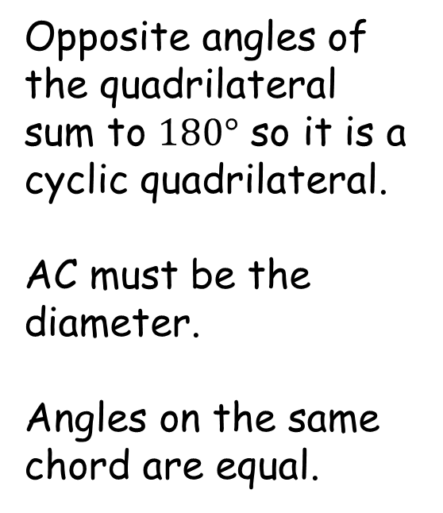





The Square of the Perpendicular
Opposite angles of the quadrilateral sum to $180°$ so it is a cyclic quadrilateral.
AC must be the diameter.
Angles on the same chord are equal.
$$D$$
$$\sqrt{925}$$
$$45°$$
$$C$$
$$45°$$
$$\sqrt{925}$$
$$30$$
$$25$$
$$\sqrt{1850}$$
$$45°$$
$$A$$
$$5$$
$$E$$
$$30$$
$$B$$

Slide 4

The Square of the Perpendicular
Area $=\frac{1}{2}\left(30+25\right)\left(30\right)+\frac{1}{2}\left(5\right)\left(30\right)$
$=\frac{1}{2}\left(30\right)\left(55+5\right)$
$=\frac{1}{2}\left(30\right)\left(60\right)$
$=900$
All areas with the same
perpendicular height are
the same.
Why doesn’t the length
of AE come into it?
Let’s use algebra, with letters standing for numbers.
$$D$$
$$\sqrt{925}$$
$$C$$
$$\sqrt{925}$$
$$30$$
$$25$$
$$\sqrt{1850}$$
$$A$$
$$5$$
$$E$$
$$30$$
$$B$$

Slide 5








The Square of the Perpendicular
$h^{2}+c^{2}=a^{2}$
${\left(h+c\right)}^{2}+b^{2}=2a^{2}$
$h^{2}+2ch+c^{2}+b^{2}=2h^{2}+2c^{2}$
$b^{2}=h^{2}−2ch+c^{2}$
$b^{2}={\left(h−c\right)}^{2}$
$b=h−c$
$$D$$
$$a$$
$$C$$
$$a$$
$$h$$
$$b$$
$$\sqrt{2}a$$
$$A$$
$$c$$
$$E$$
$$h$$
$$B$$

Slide 6


The Square of the Perpendicular
Area $=\frac{1}{2}\left(h+h−c\right)\left(h\right)+\frac{1}{2}\left(c\right)\left(h\right)$
$=\frac{1}{2}\left(h\right)\left(2h\right)$
$=h^{2}$
So the length of AE
doesn’t come in to it.
This is a consequence
of the way that the
quadrilateral was constructed.
$$D$$
$$a$$
$$C$$
$$a$$
$$h$$
$$h−c$$
$$\sqrt{2}a$$
$$A$$
$$c$$
$$E$$
$$h$$
$$B$$

Slide 7


The Square of the Perpendicular
$h^{2}$ is the area of a square
of side $h$.
Triangle DCF is congruent to
Triangle DAE so the length
of AE is irrelevant to the
area of the quadrilateral.
$$D$$
$$F$$
$$a$$
$$C$$
$$a$$
$$h$$
$$h−c$$
$$\sqrt{2}a$$
$$A$$
$$c$$
$$E$$
$$h$$
$$B$$

Slide 8
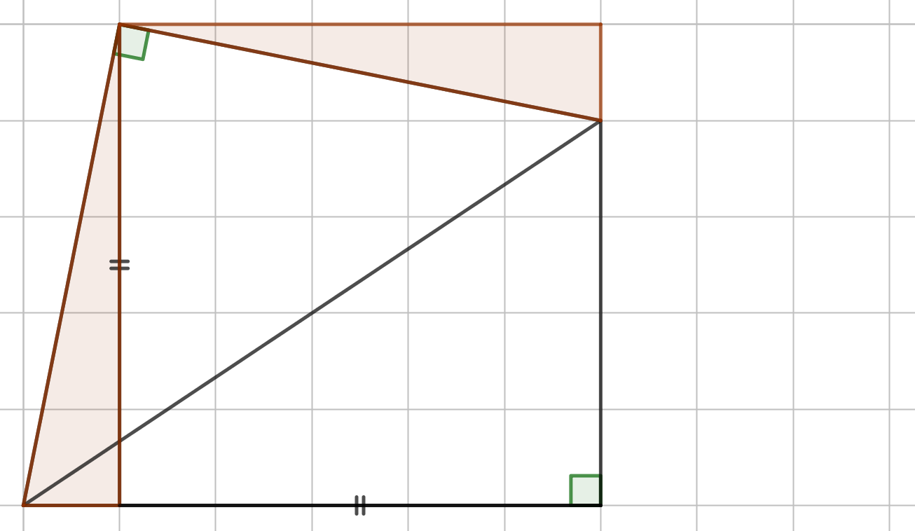
The Square of the Perpendicular

Slide 9
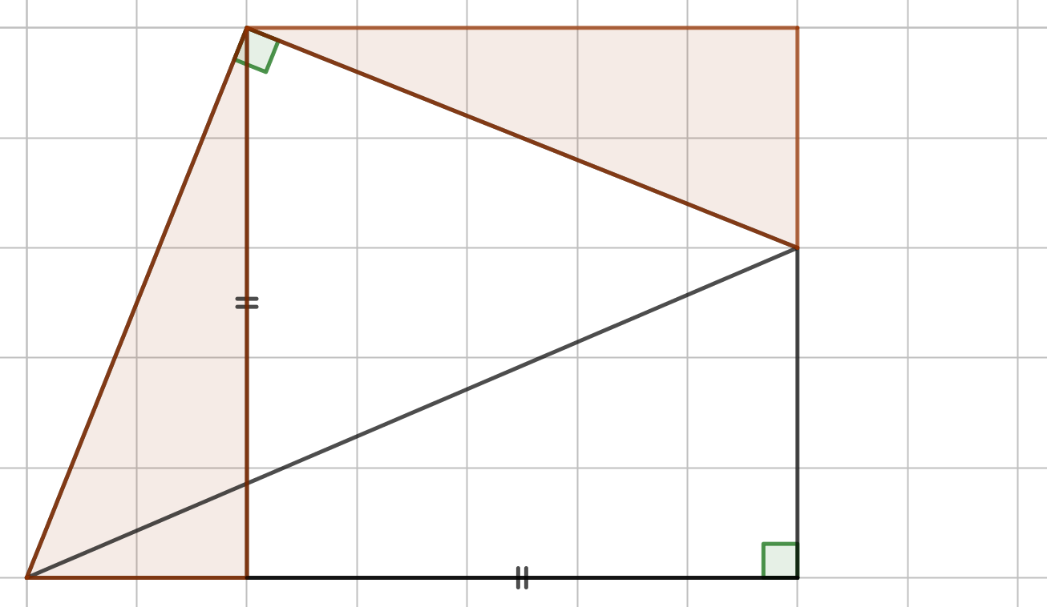
The Square of the Perpendicular

Slide 10
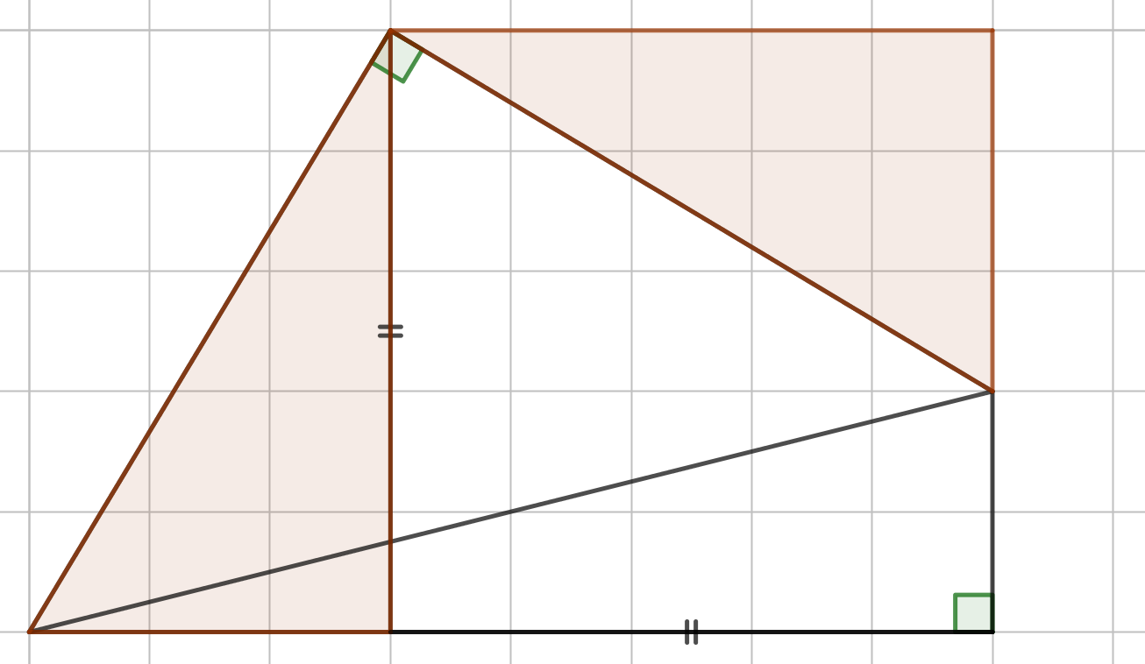
The Square of the Perpendicular

Slide 11
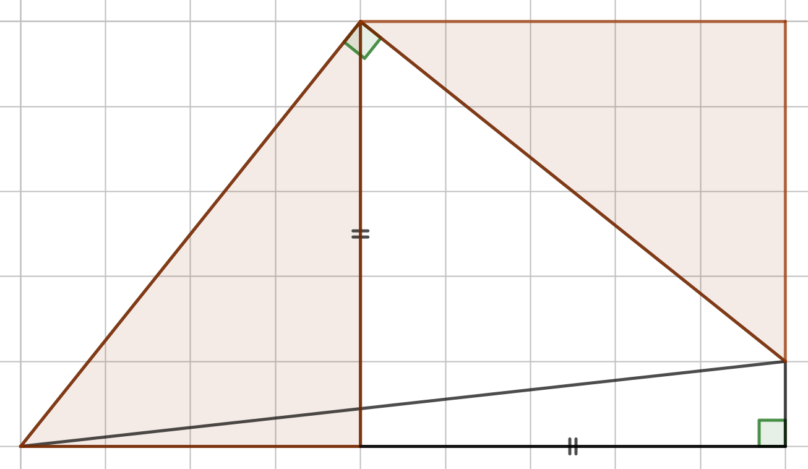
The Square of the Perpendicular
The shaded triangles are always congruent.

Slide 12
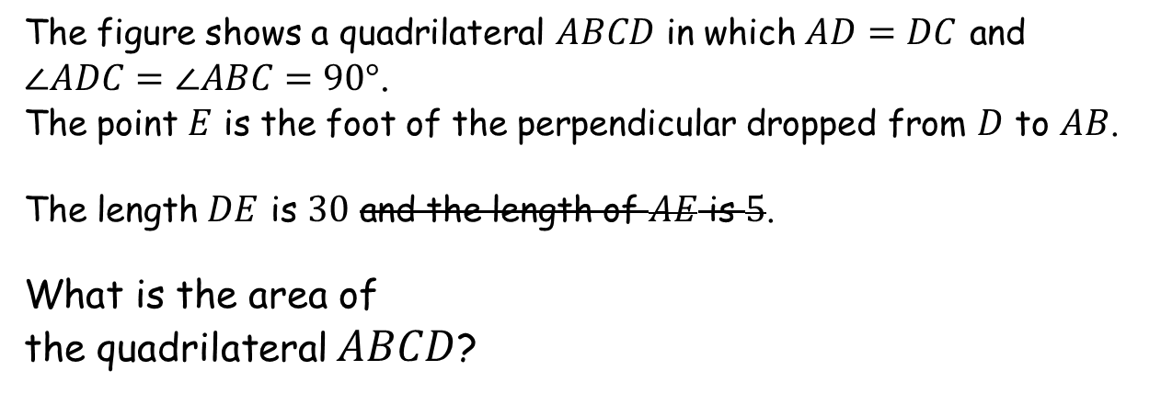
The Square of the Perpendicular
The figure shows a quadrilateral $ABCD$ in which $AD=DC$ and $\text{∠}ADC=\text{∠}ABC=90°$.
The point $E$ is the foot of the perpendicular dropped from $D$ to $AB$.
The length $DE$ is $30$ and the length of $AE$ is $5$.
What is the area of
the quadrilateral $ABCD$?
$$D$$
(Not to scale)
Do you think that you could have solved the problem without knowing length AE?
It would be quite daunting but you now know that it is possible – with the help of a bit of algebra!
$$C$$
$$A$$
$$E$$
$$B$$

Slide 14
Note to Teacher
The answer is the square of the perpendicular!
There is a Geogebra animation to demonstrate the congruent triangles.

Slide 15
RESOURCES

Slide 16
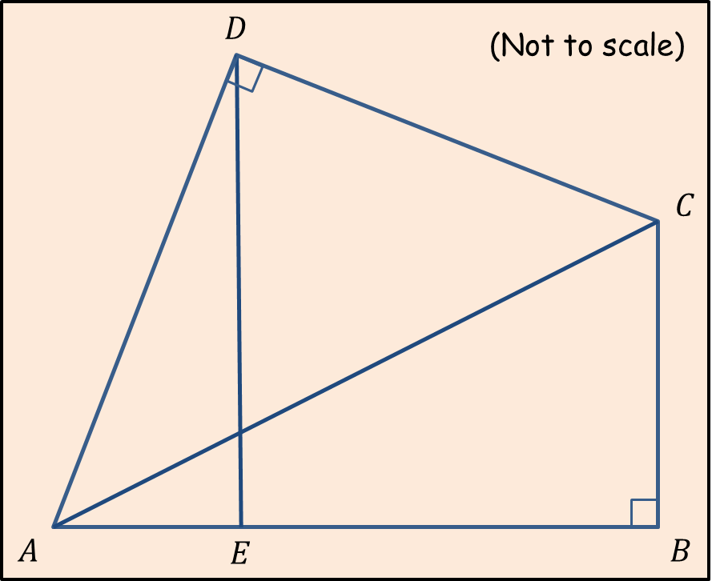
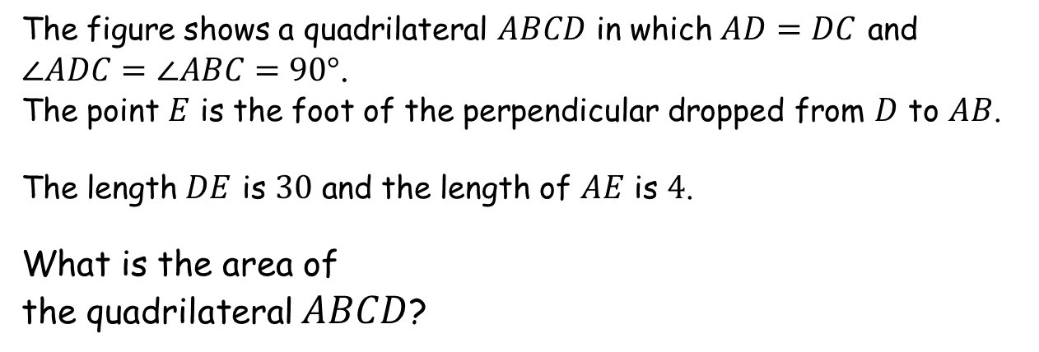
The Square of the Perpendicular
SIC_69
The figure shows a quadrilateral $ABCD$ in which $AD=DC$ and $\text{∠}ADC=\text{∠}ABC=90°$.
The point $E$ is the foot of the perpendicular dropped from $D$ to $AB$.
The length $DE$ is $30$ and the length of $AE$ is $4$.
What is the area of
the quadrilateral $ABCD$?

Slide 17
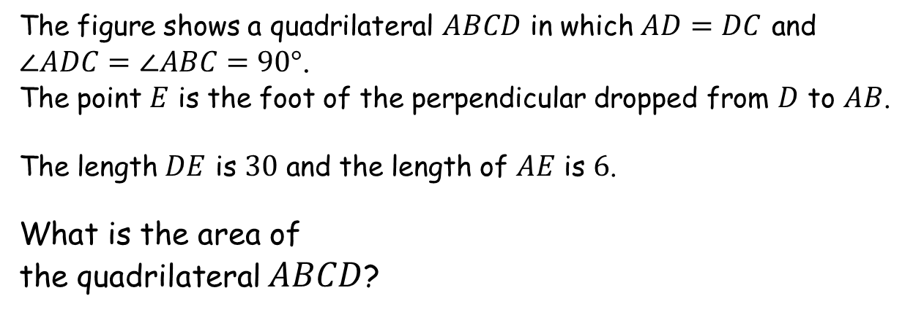
The Square of the Perpendicular
SIC_69
The figure shows a quadrilateral $ABCD$ in which $AD=DC$ and $\text{∠}ADC=\text{∠}ABC=90°$.
The point $E$ is the foot of the perpendicular dropped from $D$ to $AB$.
The length $DE$ is $30$ and the length of $AE$ is $6$.
What is the area of
the quadrilateral $ABCD$?

Slide 18
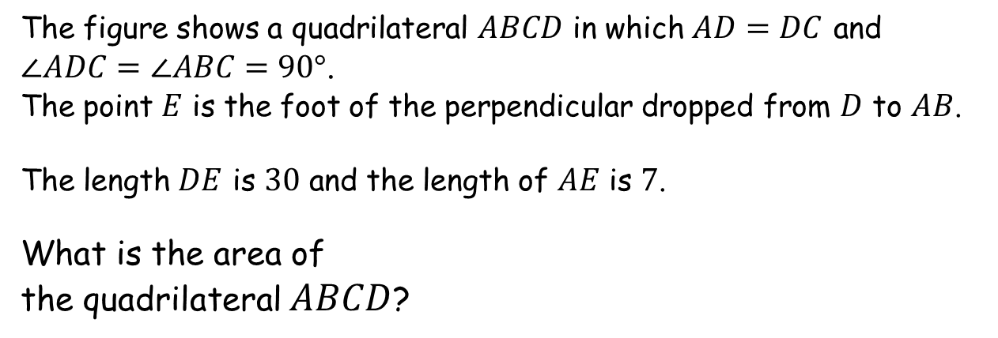
The Square of the Perpendicular
SIC_69
The figure shows a quadrilateral $ABCD$ in which $AD=DC$ and $\text{∠}ADC=\text{∠}ABC=90°$.
The point $E$ is the foot of the perpendicular dropped from $D$ to $AB$.
The length $DE$ is $30$ and the length of $AE$ is $7$.
What is the area of
the quadrilateral $ABCD$?

Slide 19
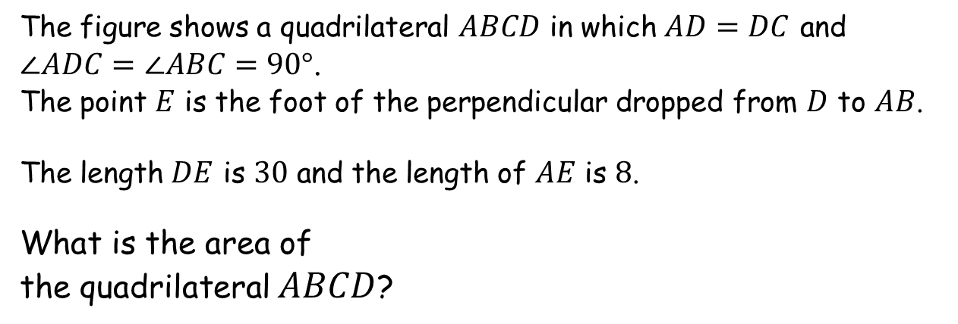
The Square of the Perpendicular
SIC_69
The figure shows a quadrilateral $ABCD$ in which $AD=DC$ and $\text{∠}ADC=\text{∠}ABC=90°$.
The point $E$ is the foot of the perpendicular dropped from $D$ to $AB$.
The length $DE$ is $30$ and the length of $AE$ is $8$.
What is the area of
the quadrilateral $ABCD$?

Slide 20
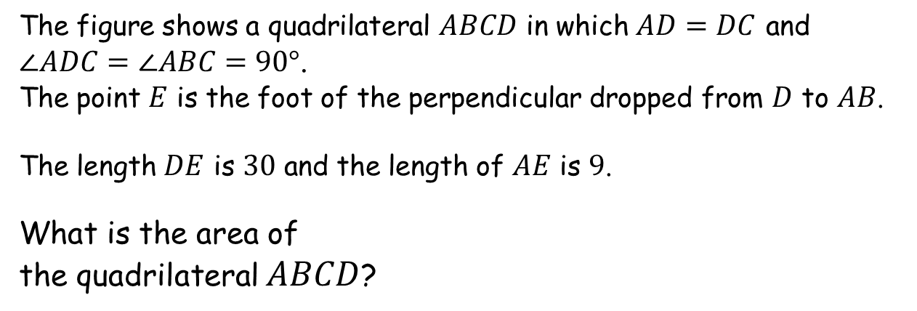
The Square of the Perpendicular
SIC_69
The figure shows a quadrilateral $ABCD$ in which $AD=DC$ and $\text{∠}ADC=\text{∠}ABC=90°$.
The point $E$ is the foot of the perpendicular dropped from $D$ to $AB$.
The length $DE$ is $30$ and the length of $AE$ is $9$.
What is the area of
the quadrilateral $ABCD$?

Slide 21
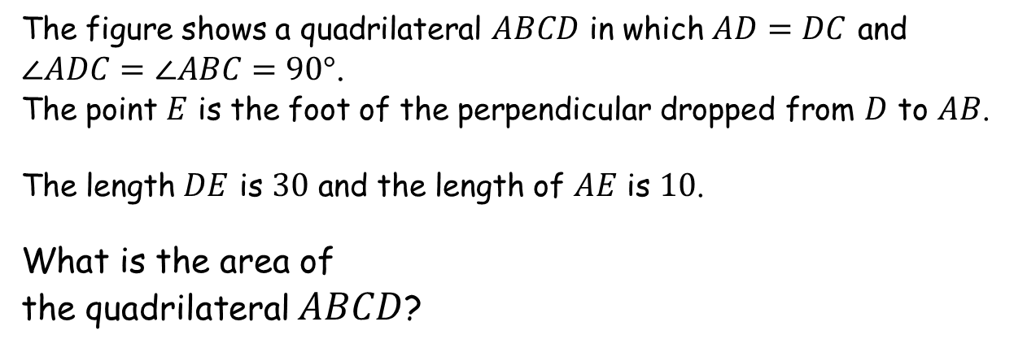
The Square of the Perpendicular
SIC_69
The figure shows a quadrilateral $ABCD$ in which $AD=DC$ and $\text{∠}ADC=\text{∠}ABC=90°$.
The point $E$ is the foot of the perpendicular dropped from $D$ to $AB$.
The length $DE$ is $30$ and the length of $AE$ is $10$.
What is the area of
the quadrilateral $ABCD$?

Slide 22
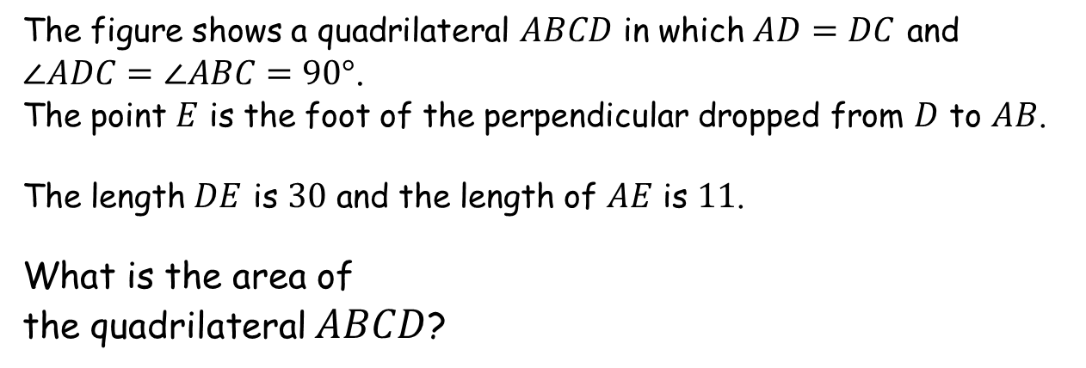
The Square of the Perpendicular
SIC_69
The figure shows a quadrilateral $ABCD$ in which $AD=DC$ and $\text{∠}ADC=\text{∠}ABC=90°$.
The point $E$ is the foot of the perpendicular dropped from $D$ to $AB$.
The length $DE$ is $30$ and the length of $AE$ is $11$.
What is the area of
the quadrilateral $ABCD$?

Slide 23
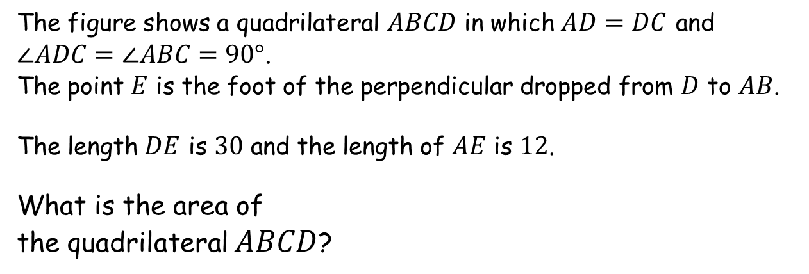
The Square of the Perpendicular
SIC_69
The figure shows a quadrilateral $ABCD$ in which $AD=DC$ and $\text{∠}ADC=\text{∠}ABC=90°$.
The point $E$ is the foot of the perpendicular dropped from $D$ to $AB$.
The length $DE$ is $30$ and the length of $AE$ is $12$.
What is the area of
the quadrilateral $ABCD$?

Slide 24
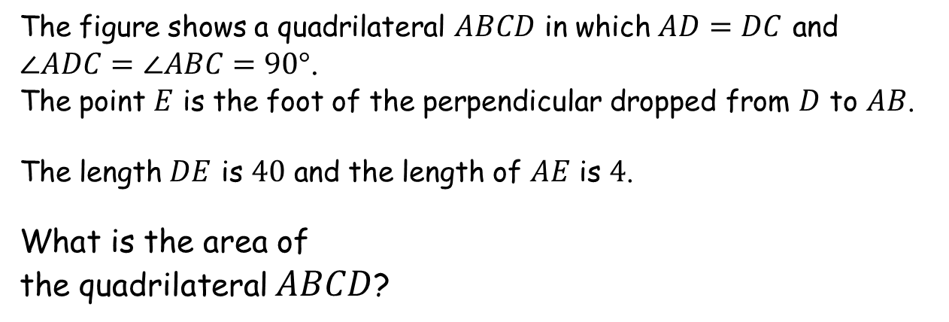
The Square of the Perpendicular
SIC_69
The figure shows a quadrilateral $ABCD$ in which $AD=DC$ and $\text{∠}ADC=\text{∠}ABC=90°$.
The point $E$ is the foot of the perpendicular dropped from $D$ to $AB$.
The length $DE$ is $40$ and the length of $AE$ is $4$.
What is the area of
the quadrilateral $ABCD$?

Slide 25
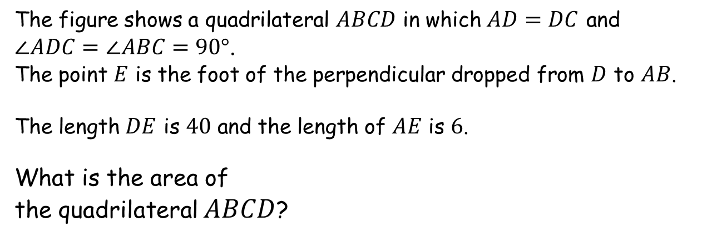
The Square of the Perpendicular
SIC_69
The figure shows a quadrilateral $ABCD$ in which $AD=DC$ and $\text{∠}ADC=\text{∠}ABC=90°$.
The point $E$ is the foot of the perpendicular dropped from $D$ to $AB$.
The length $DE$ is $40$ and the length of $AE$ is $6$.
What is the area of
the quadrilateral $ABCD$?

Slide 26
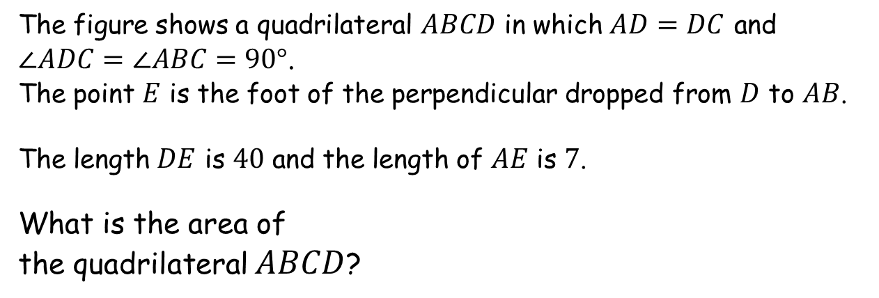
The Square of the Perpendicular
SIC_69
The figure shows a quadrilateral $ABCD$ in which $AD=DC$ and $\text{∠}ADC=\text{∠}ABC=90°$.
The point $E$ is the foot of the perpendicular dropped from $D$ to $AB$.
The length $DE$ is $40$ and the length of $AE$ is $7$.
What is the area of
the quadrilateral $ABCD$?

Slide 27
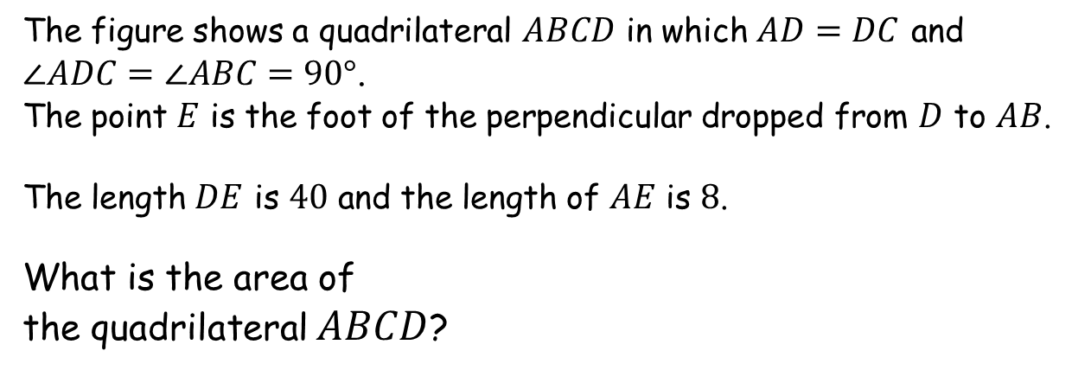
The Square of the Perpendicular
SIC_69
The figure shows a quadrilateral $ABCD$ in which $AD=DC$ and $\text{∠}ADC=\text{∠}ABC=90°$.
The point $E$ is the foot of the perpendicular dropped from $D$ to $AB$.
The length $DE$ is $40$ and the length of $AE$ is $8$.
What is the area of
the quadrilateral $ABCD$?

Slide 28
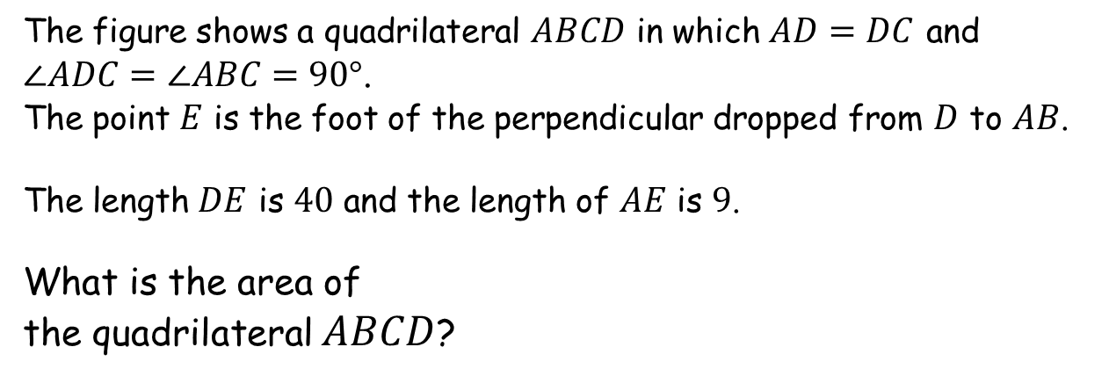
The Square of the Perpendicular
SIC_69
The figure shows a quadrilateral $ABCD$ in which $AD=DC$ and $\text{∠}ADC=\text{∠}ABC=90°$.
The point $E$ is the foot of the perpendicular dropped from $D$ to $AB$.
The length $DE$ is $40$ and the length of $AE$ is $9$.
What is the area of
the quadrilateral $ABCD$?

Slide 29
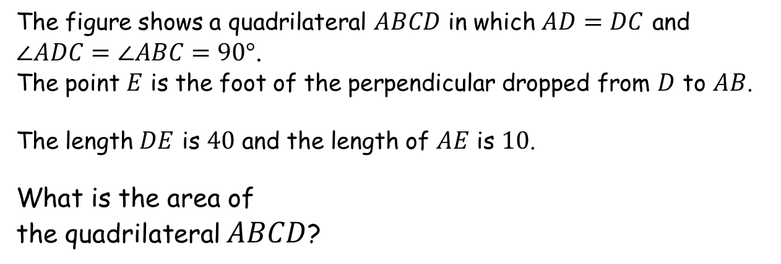
The Square of the Perpendicular
SIC_69
The figure shows a quadrilateral $ABCD$ in which $AD=DC$ and $\text{∠}ADC=\text{∠}ABC=90°$.
The point $E$ is the foot of the perpendicular dropped from $D$ to $AB$.
The length $DE$ is $40$ and the length of $AE$ is $10$.
What is the area of
the quadrilateral $ABCD$?

Slide 30
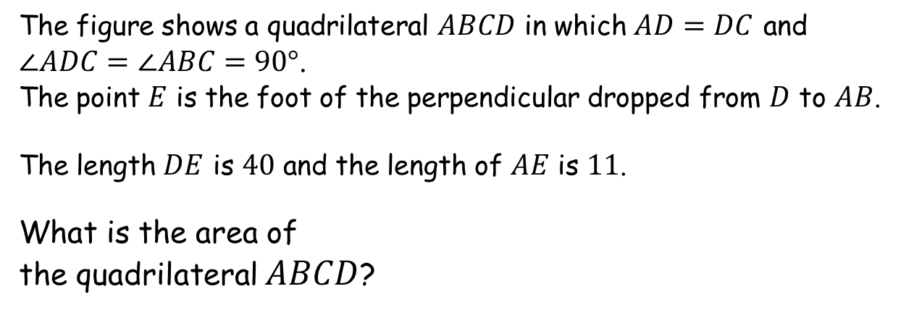
The Square of the Perpendicular
SIC_69
The figure shows a quadrilateral $ABCD$ in which $AD=DC$ and $\text{∠}ADC=\text{∠}ABC=90°$.
The point $E$ is the foot of the perpendicular dropped from $D$ to $AB$.
The length $DE$ is $40$ and the length of $AE$ is $11$.
What is the area of
the quadrilateral $ABCD$?

Slide 31
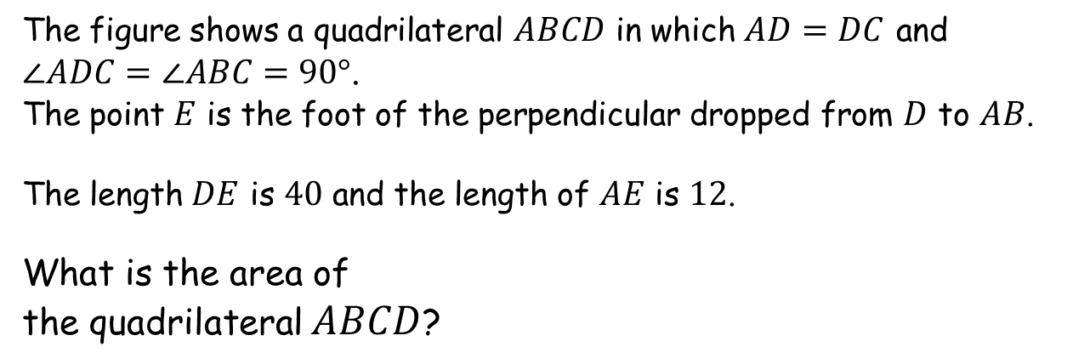
The Square of the Perpendicular
SIC_69
The figure shows a quadrilateral $ABCD$ in which $AD=DC$ and $\text{∠}ADC=\text{∠}ABC=90°$.
The point $E$ is the foot of the perpendicular dropped from $D$ to $AB$.
The length $DE$ is $40$ and the length of $AE$ is $12$.
What is the area of
the quadrilateral $ABCD$?

Slide 32
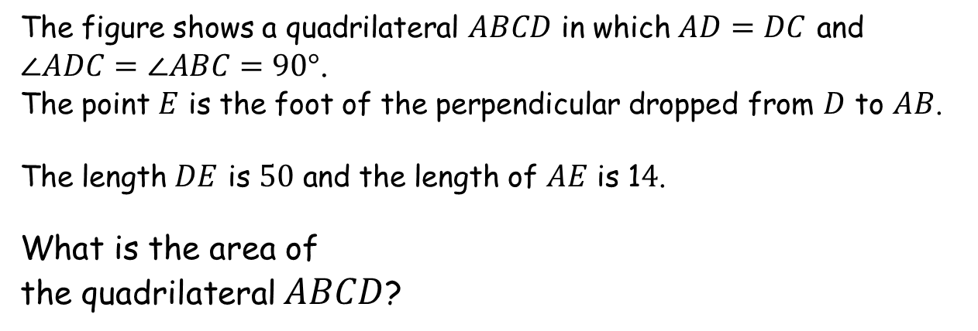
The Square of the Perpendicular
SIC_69
The figure shows a quadrilateral $ABCD$ in which $AD=DC$ and $\text{∠}ADC=\text{∠}ABC=90°$.
The point $E$ is the foot of the perpendicular dropped from $D$ to $AB$.
The length $DE$ is $50$ and the length of $AE$ is 1$4$.
What is the area of
the quadrilateral $ABCD$?

Slide 33
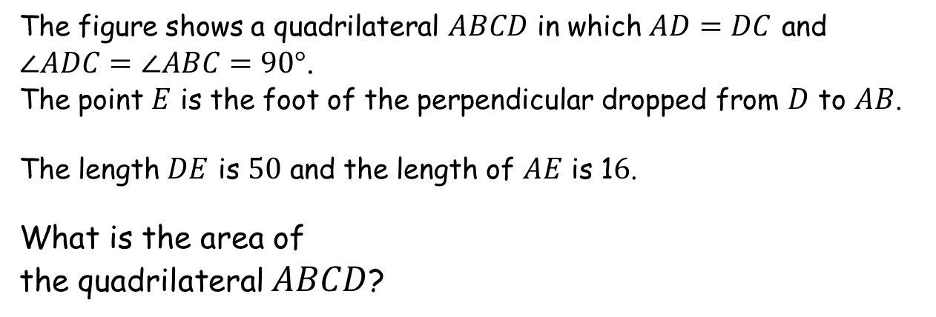
The Square of the Perpendicular
SIC_69
The figure shows a quadrilateral $ABCD$ in which $AD=DC$ and $\text{∠}ADC=\text{∠}ABC=90°$.
The point $E$ is the foot of the perpendicular dropped from $D$ to $AB$.
The length $DE$ is $50$ and the length of $AE$ is 1$6$.
What is the area of
the quadrilateral $ABCD$?

Slide 34
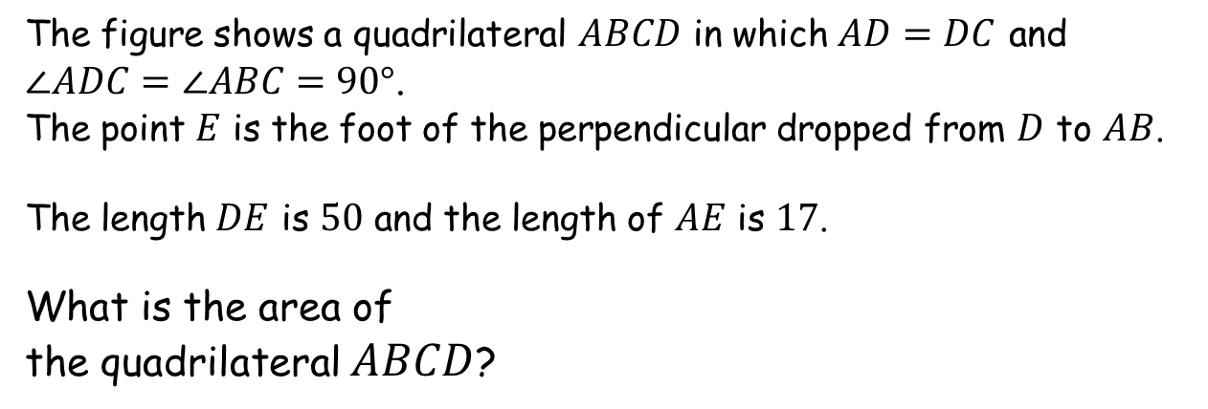
The Square of the Perpendicular
SIC_69
The figure shows a quadrilateral $ABCD$ in which $AD=DC$ and $\text{∠}ADC=\text{∠}ABC=90°$.
The point $E$ is the foot of the perpendicular dropped from $D$ to $AB$.
The length $DE$ is $50$ and the length of $AE$ is $17$.
What is the area of
the quadrilateral $ABCD$?

Slide 35
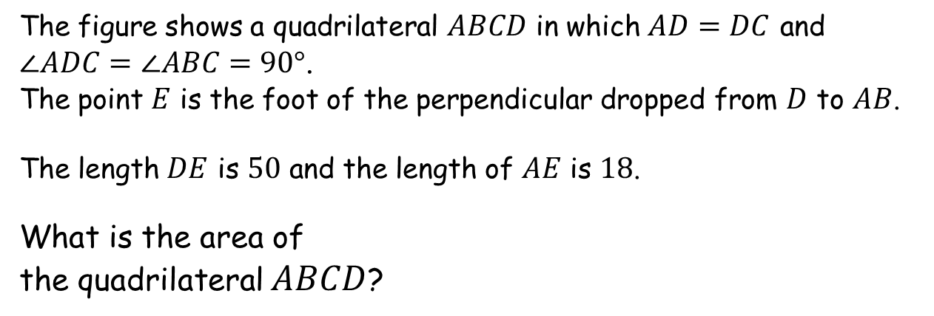
The Square of the Perpendicular
SIC_69
The figure shows a quadrilateral $ABCD$ in which $AD=DC$ and $\text{∠}ADC=\text{∠}ABC=90°$.
The point $E$ is the foot of the perpendicular dropped from $D$ to $AB$.
The length $DE$ is $50$ and the length of $AE$ is $18$.
What is the area of
the quadrilateral $ABCD$?

Slide 36
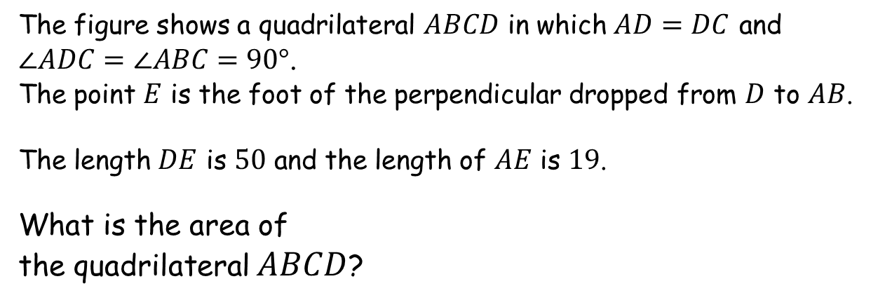
The Square of the Perpendicular
SIC_69
The figure shows a quadrilateral $ABCD$ in which $AD=DC$ and $\text{∠}ADC=\text{∠}ABC=90°$.
The point $E$ is the foot of the perpendicular dropped from $D$ to $AB$.
The length $DE$ is $50$ and the length of $AE$ is $19$.
What is the area of
the quadrilateral $ABCD$?

Slide 37
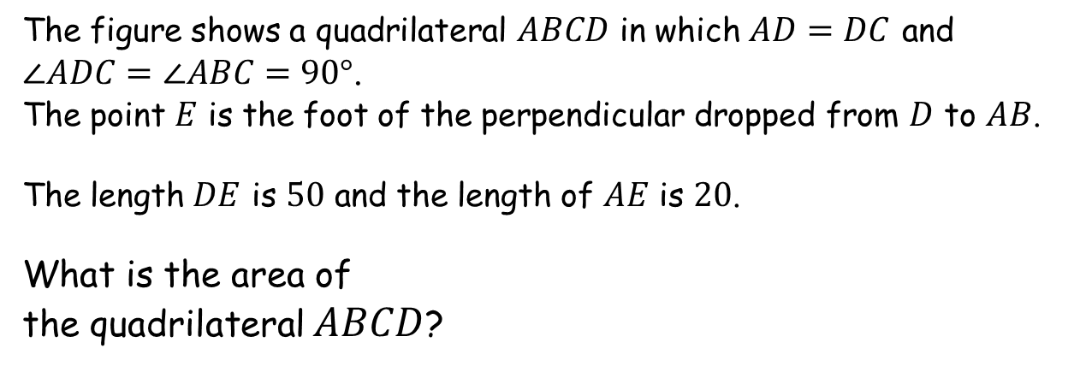
The Square of the Perpendicular
SIC_69
The figure shows a quadrilateral $ABCD$ in which $AD=DC$ and $\text{∠}ADC=\text{∠}ABC=90°$.
The point $E$ is the foot of the perpendicular dropped from $D$ to $AB$.
The length $DE$ is $50$ and the length of $AE$ is $20$.
What is the area of
the quadrilateral $ABCD$?

Slide 38
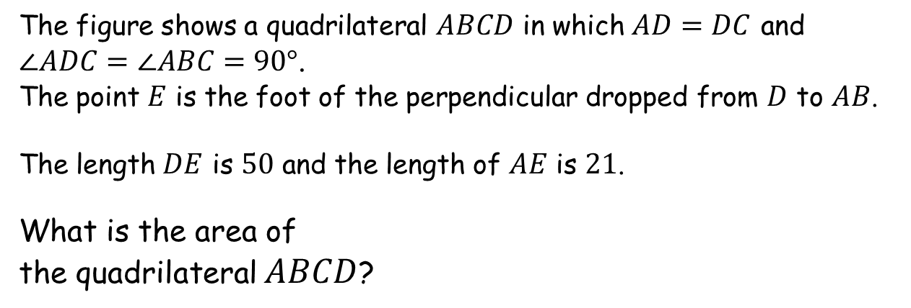
The Square of the Perpendicular
SIC_69
The figure shows a quadrilateral $ABCD$ in which $AD=DC$ and $\text{∠}ADC=\text{∠}ABC=90°$.
The point $E$ is the foot of the perpendicular dropped from $D$ to $AB$.
The length $DE$ is $50$ and the length of $AE$ is $21$.
What is the area of
the quadrilateral $ABCD$?

Slide 39
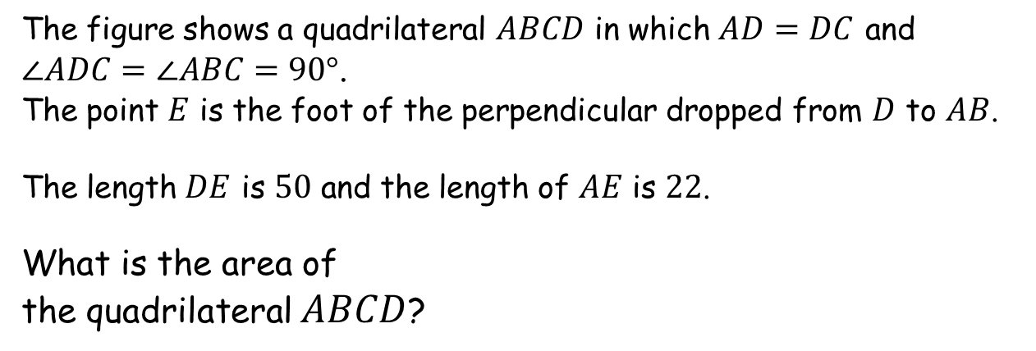
The Square of the Perpendicular
SIC_69
The figure shows a quadrilateral $ABCD$ in which $AD=DC$ and $\text{∠}ADC=\text{∠}ABC=90°$.
The point $E$ is the foot of the perpendicular dropped from $D$ to $AB$.
The length $DE$ is $50$ and the length of $AE$ is $22$.
What is the area of
the quadrilateral $ABCD$?

